Slide 1
Leaf and photosynthesis
IGCSE Biology
Wendy Chai

Slide 2
Key questions
Balanced chemical equation for photosynthesis.
What are raw materials needed for photosynthesis？
How do plant obtain them?
What is produced by photosynthesis?
What happens to the products of photosynthesis?
How do plant make use of the product?
How are leaves/plants adapted for performing photosynthesis?
How can you measure rate of photosynthesis?
Can you design experiments to prove plant need light, CO2, chlorophyll, respectively for photosynthesis?
Can you design experiments to investigate how do CO2 concentration, light intensity, color of light affect rate of photosynthesis?
What factors can affect rate of photosynthesis?

Slide 3
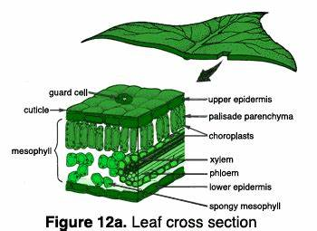
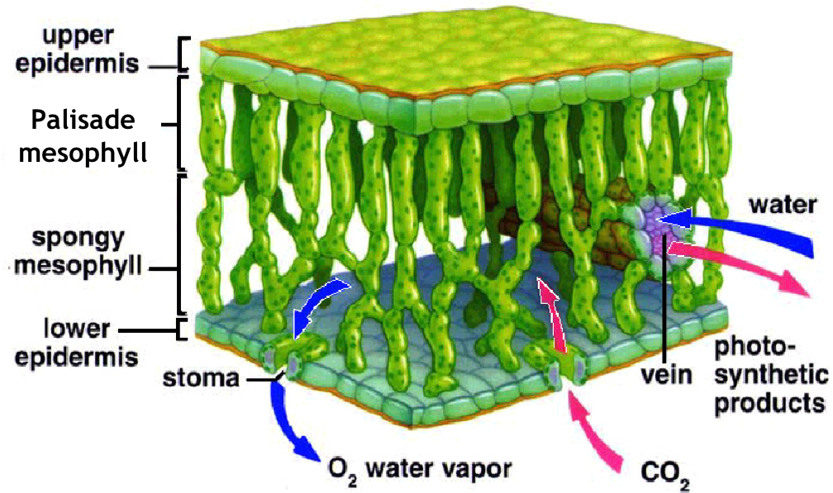
Leaf Structure
waxy cuticle
Lamina – leaf blade
Midrib – main vein

Slide 4
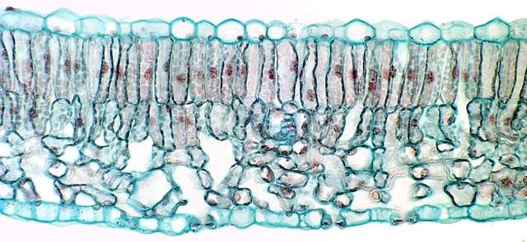
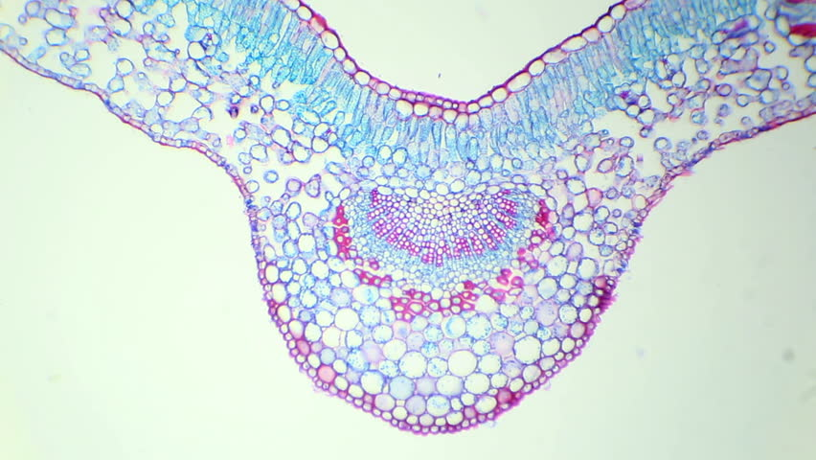

Slide 5
Leaf adaptations
Page 63 on coursebook

Slide 6
How are leaves adapted
Leaf adaptations | How does this help with leaf’s function
Broad and flat | Large surface area to be exposed to sunlight & air
petiole | Holds leaf in position to absorb maximum light
Extensive veins | 1 Xylem vessels supply water to and phloem tubes take away sucrose from cells; 2 support leaves
Plant cells contain chloroplasts | Allow photosynthesis
Stomata in lower epidermis | Allow gas exchange (CO2 in and O2 out)
Guard cells | Control opening and closing of stomata hence stop too much water loss from the leaf
Waxy cuticle | Reduce water loss by evaporation from the leaf
Very thin leaf & interconnecting Air space/ chambers in leaf | Allow rapid diffusion of CO2 to and O2 from all cells
Transparent epidermis | Allow sunlight easily penetrate to the mesophyll layer
Palisade cells packed tightly and end on (upright) | Keep as fewer cell walls as possible to allow least sunlight loss

Slide 7
Deficiency symptoms

Slide 8
Plant nutrients
Nutrient | Why it is needed | Deficiency symptoms
Nitrate | For protein synthesis and growth of leaves and stems | Poor, stunted growth and yellow older leaves
Magnesium | For healthy leaves and formation of chlorophyll | poor growth and yellowing between the veins on leaves where the veins stay green
Phosphate | For healthy roots | Poor root growth and purple younger leaves
Potassium | For healthy leaves, flowers and fruits | Yellow leaves and dead spots

Slide 9
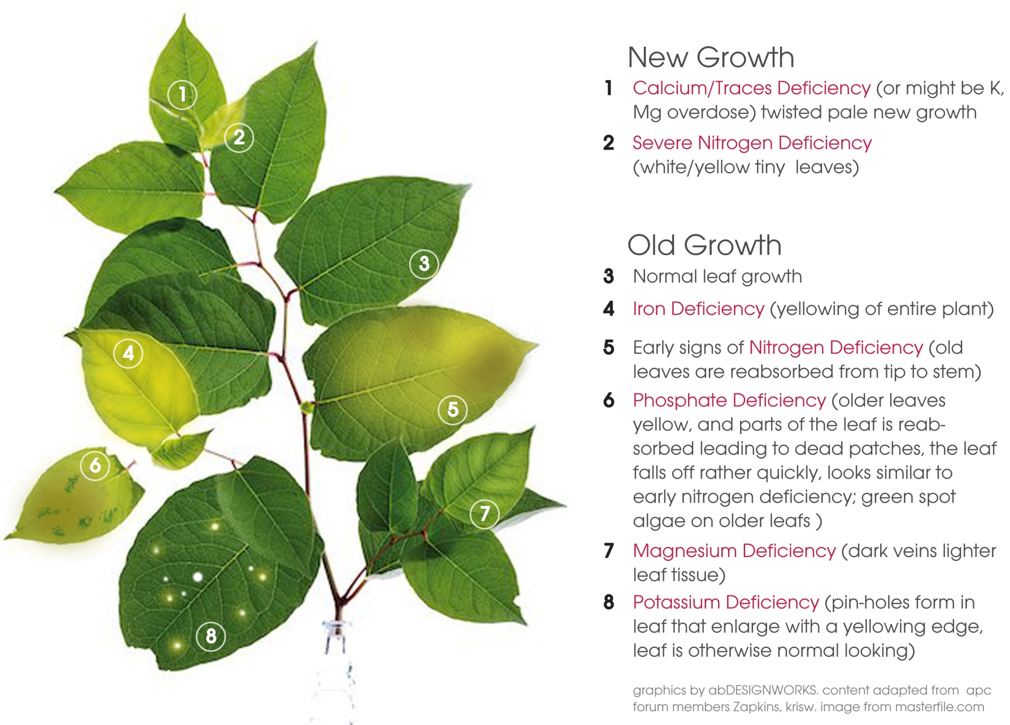

deficiency symptoms

Slide 10
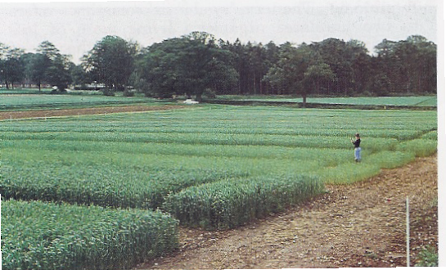
Effects of fertilisers
21
These are experimental strips of wheat. Varying amounts and types of fertiliser have been added to the soil to see which give the best plant growth
Notes:
Some of these plots have received different types of fertiliser.
Some have had only manure added to the soil.
Some had neither manure nor fertiliser for many years

Slide 11
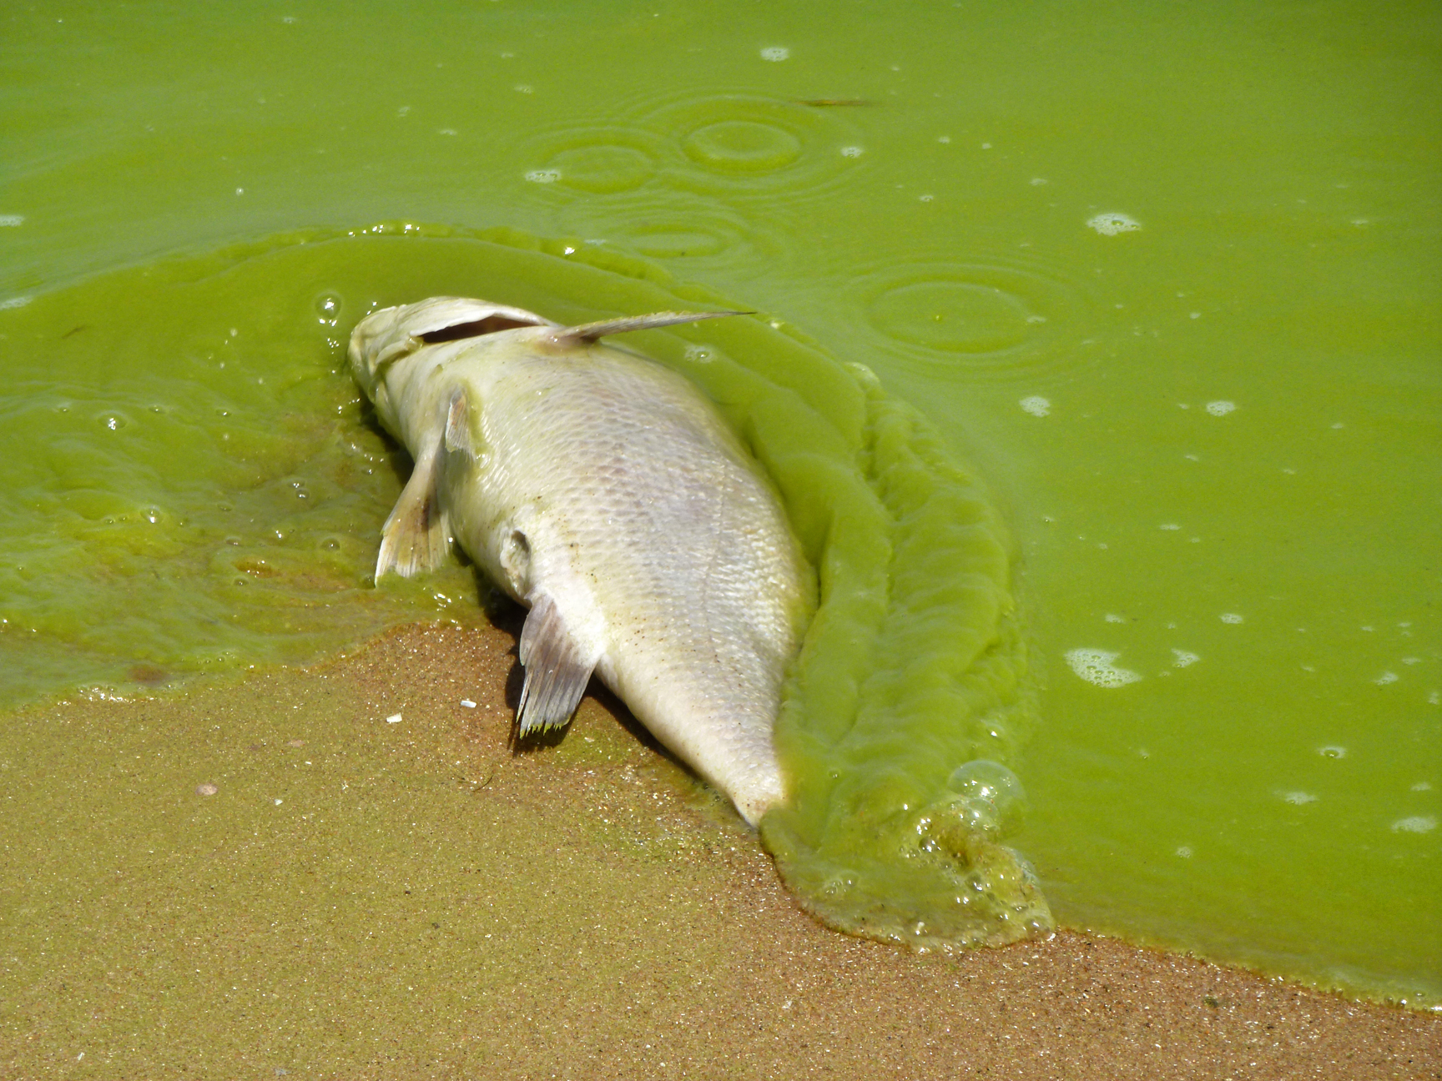
Eutrophication

Slide 12
Photosynthesis
IGCSE Biology
Wendy Chai

Slide 13
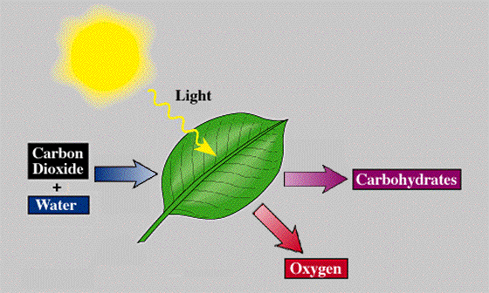
Photosynthesis

Slide 14
Photosynthesis
1 Write out word equation of photosynthesis.
2 Write out balanced equation of photosynthesis.
3 What are the raw materials of photosynthesis? How do plant obtain each of them?
sunlight
Carbon dioxide + water glucose + oxygen
chlorophyll
sunlight
6CO₂ + 6H₂O C₆H₁₂O₆ + 6O₂
chlorophyll

Slide 15
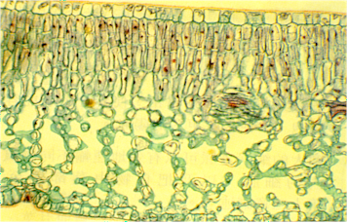
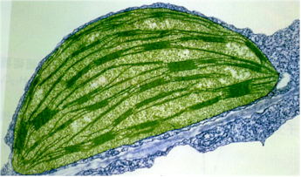
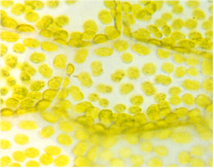
Quick Revision :
Where does photosynthesis occur？
Leaf
Palisade
mesophyll
Chloroplast under electron microscope
Chloroplast

Slide 16
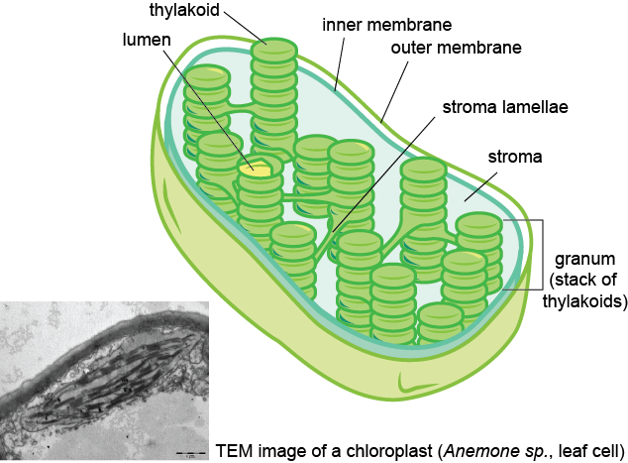
These words are not required to know for now.

Slide 17
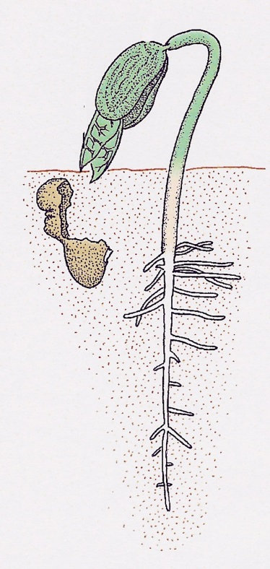
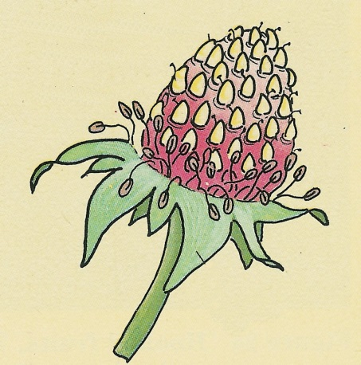
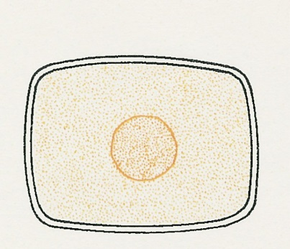
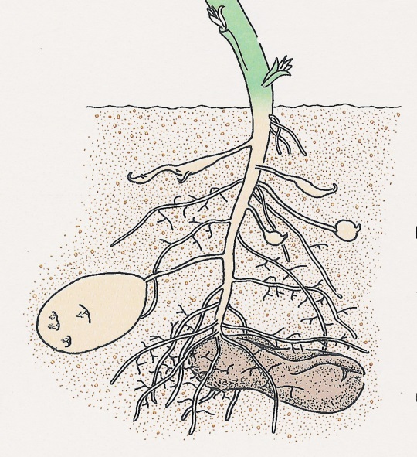
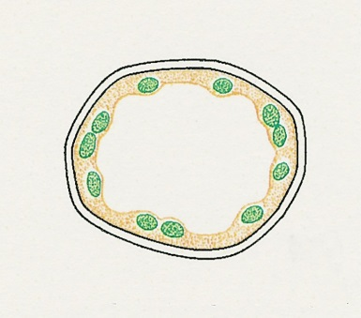
Uses of glucose
18
other sugars
Fruits(sucrose)
energy
e.g. seed germination
GLUCOSE
protein
starch
cytoplasm
cellulose
cell walls
storage e.g. starch in seeds, leaves, roots

Slide 18
Photosynthesis experiments/ investigations

Slide 19
1 How can you demonstrate/ prove photosynthesis has occured?
Hint:
What to measure?
Can we demonstrate what has been produced?
Any key actions you need to take before you measure?

Slide 20
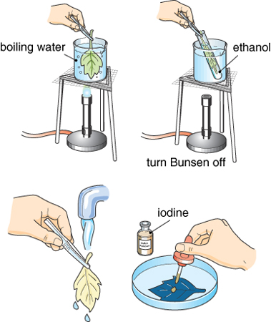
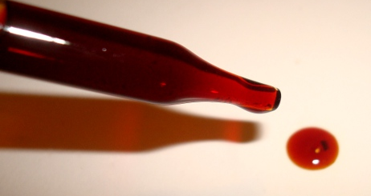
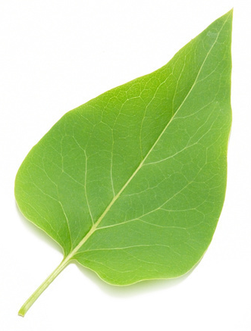
Testing leaves for starch
Activity 6.2, Page 65

Slide 21
Before all investigations
Destarch the plant
(24-48h in dark)

Slide 22
Investigations
1. To see if starch is produced in photosynthesis.
2. To see if light is needed for photosynthesis. (Activity 6.3, Page66)
3. To see if chlorophyll is needed for photosynthesis.(Activity 6.4, Page67)
4. To see if CO₂ is needed for photosynthesis.
5. To see if O₂ is produced in photosynthesis .(Activity 6.5, Page67)
Hint: Do not forget to set up a control group. Why?
A) allow for comparison
B) results more reliable
C) proves any difference in results between experimental treatments and the control group is caused by the difference in independent variable (the only variable that is changed among groups).
Notes:
You have two pairs of shoes, you wanna know which one assists running better. What should you do?

Slide 23
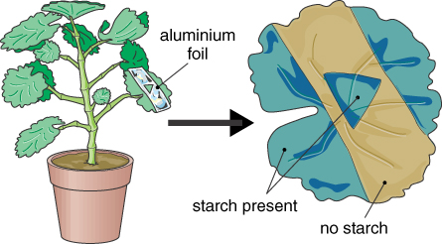
Whether light is needed for photosynthesis

Slide 24
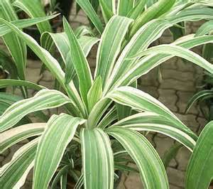
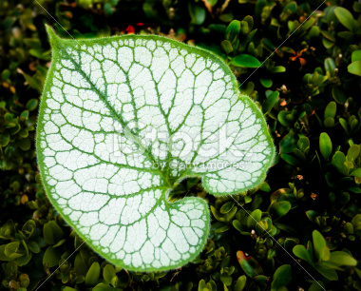
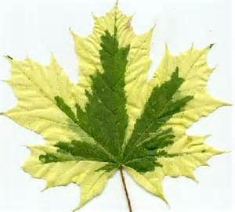
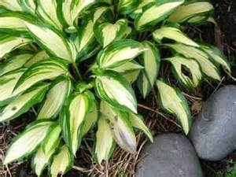
Whether chlorophyll is needed for photosynthesis
Variegated leaves
No chlorophyll
Chlorophyll

Slide 25
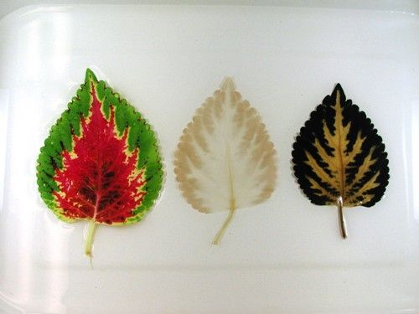
Whether chlorophyll is needed for photosynthesis

Slide 26
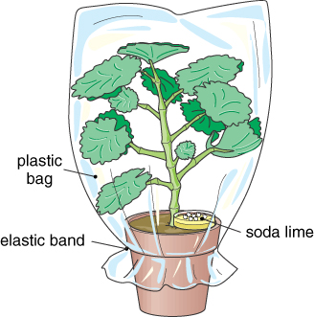
Whether CO₂ is needed for photosynthesis
Soda lime (or sodium hydroxide) absorbs carbon dioxide.

Slide 27


How can you measure the rate of photosynthesis
Hint: review of how do you measure the rate of reaction below
(catalase)
H₂O₂ H₂O + O₂

Slide 28
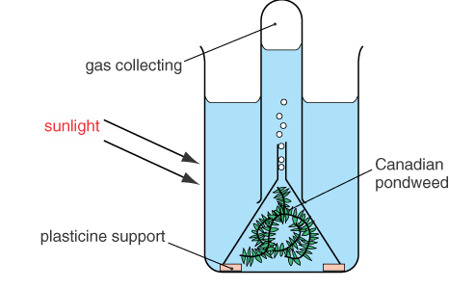
Measure rate of photosynthesis
Hint:
Use of water plants

Slide 29
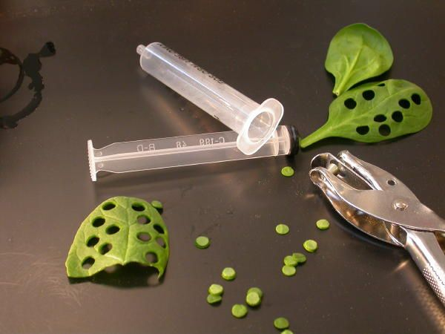
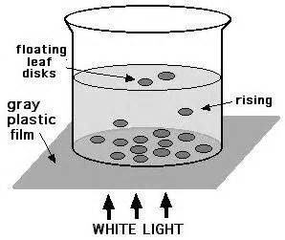
Measure rate of photosynthesis
There are numerous methods to measure the rate of photosynthesis.
1) count oxygen bubbles or collect O₂ from water weed or …
2) hydrogencarbonate indicator –
bicarbonate indicator solution turns purple from red when CO2 is removed and yellow when CO2 is produced

Slide 30
Notes:
hydrogencarbonate indicator) is a type of pH indicator that is sensitive enough to show a color change as the concentration of carbon dioxide gas in an aqueous solution increases. The indicator is used in photosynthesis and respiration experiments to find out whether carbon dioxide is being liberated.
Great care must be taken to avoid acidic or alkaline contamination of the apparatus in such experiments, since the test is not directly specific to gases like carbon dioxide.

Slide 31
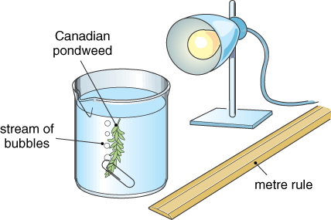
Measure rate of photosynthesis

Slide 32
Measure rate of photosynthesis
We need to keep most factors constant, such as:
the amount (and type, age) of plant material
the time used to collect the oxygen (time length)
the volume of water
the type and size of apparatus.

Slide 33
Quick Quiz 1
1. What does a plant need for photosynthesis?
Carbon dioxide, water, chlorophyll, light.
2. What does a leaf produce during photosynthesis?
Oxygen, glucose
3. What is chlorophyll?
A green pigment which absorbs the sun’s energy
4. How do the leaves obtain water?
Through the roots (and xylem tubes by osmosis
5. How does the plant obtain carbon dioxide?
From the air (through stomata)
6. List 3 uses of the glucose produced by photosynthesis?
Cellulose (structural), starch (storage), energy
7. Name the storage form of carbohydrate in a leaf.
Starch.

Slide 34
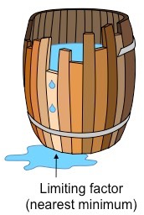
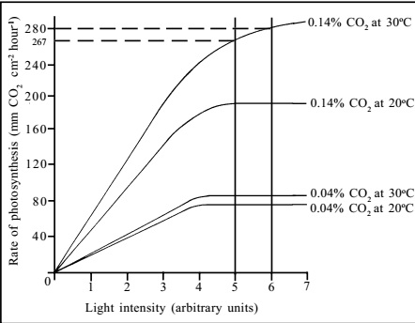
Limiting Factors
Definition:
The environment element/ factor that restricts life processes when it is in such short supply.
1 What might be limiting factors of photosynthesis?
2 What might be limiting factors of plant growth?

Slide 35
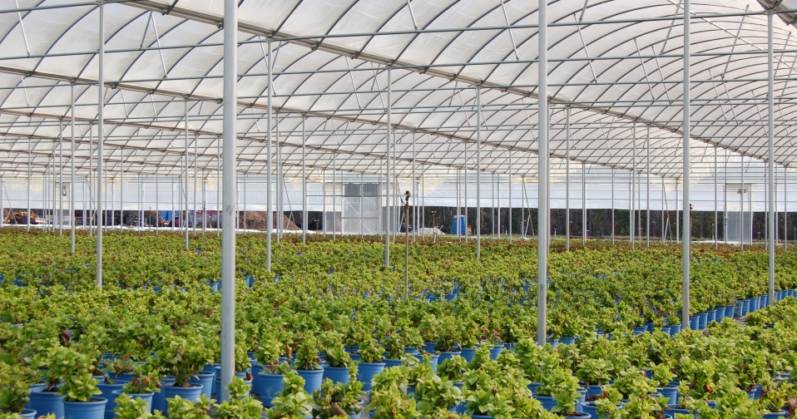
Greenhouses

